Slide 1

PROFESSIONALISM AND THE CSP
Ngozi Onuegbu PhD
PT7002/PT4051

Slide 2
Learning Outcomes:
Understand the CSP and its role in professional practice
Identify the knowledge, skills, behaviour, and values underpinning Physiotherapy practice
Code of Members professional values and behaviour

Slide 3
What is Professionalism?
qualities, skills, competence and behaviours you are expected to bring to physiotherapy.
CSP https://www.csp.org.uk/content/what-professionalism

Slide 4
What is the HCPC? Global context.
Health and Care Professions Council.
Regulator of health and care professions in the UK
15 Professions
Key Roles:
TO PROTECT THE PUBLIC.
Set standards
Program approval
Notes:
15 health and care professions in the UK
By law, people must be registered with us to work in the UK in any of the
set standards for professionals' education and training and practice;

Slide 5

Timeline of introduction of the revised SOPs
Summer 2022
From 2022-23 academic year
• Revised SOPs released • Requirements provided to education providers
September 2023
Report approach / changes through performance review submissions
Deliver revised SOPs to new cohorts

Slide 6
Thematic revisions to the SOPs
Active
implementation
of the
standards
Equality,
diversity and
inclusion
Registrants’ mental health
Leadership
Promoting
public health
and preventing
ill-health
Further
centralising the
service user
Digital skills
and new
technologies

Slide 7
Active implementation of the standards
Changed wording moving away from passive understanding, to active implementation
Reflects the importance of registrants being autonomous and caring professionals |  | More active wording makes our expectations of registrants clearer
Education providers already considered SOPs as ‘active’ when teaching and assessing
Due to the need to deliver and actively assess competence, to ensure learners are fit to practice | Learners need to actively demonstrate how they meet each SOP through existing programme assessments |  | It is not possible to do this in a passive way

Slide 8
Further centralising the service user
Improved the central role of the service-user, including registrants understanding the importance of consent and effective communication in providing good care
How we understand consent has evolved | Registrants need to take a wider range of circumstances into account when determining consent |  | Strengthened standards on confidentiality, including referencing implications of emerging technology
Education providers addressed this theme through
Referencing existing modular content - most education providers had existing modules which already contained or were updated in line with our requirements |  | Referencing how contact with service users and carers informed learners when developing their practice

Slide 9
Revised SOPs
Active
implementation
of the
standards
Equality,
diversity and
inclusion
Registrants’ mental health
Leadership
Promoting
public health
and preventing
ill-health
Further
centralising the
service user
Digital skills
and new
technologies

Slide 10






Registrants’ mental health
Education providers addressed this theme through
• Embedding into programme curricula
• Ensuring appropriate support for
learner mental health was in place, including new support mechanisms where they were needed
• Good practice to provide an
underpinning to support future
registrants managing their own mental
Emphasised the importance that registrants look after their own mental health, and seek help where necessary
• Our previous standards were less
about the registrant and their health,
and more focused on fitness to practise
• Wording reflects our position as a ‘compassionate regulator’ and the
centrality of registrant wellness
• Still links to the fitness to practise of registrants
health

Slide 11
Leadership
Education providers addressed this theme through
• Leadership already embedded in some way
• Some (usually masters level)
programmes explicitly focused on
‘growing the next generation of leaders’
• Practice-based learning opportunities – usually final placements had leadership embedded, as learners feel more
Emphasised the role and importance of leadership at all levels of practice • Important that registrants are autonomous professionals • This includes displaying leadership without needing to be in a management role
autonomous at this point in programmes
• Review of teaching and learning

Slide 12
HCPC Standards of Proficiency.
Revised standards effective 1st September 2023
Standards of Proficiency Document for Physiotherapists
HCPC Standards of Proficiency
Expectations of You: Commitment to standards
Your Scope of Practice: Ever changing
Meeting the standards: Evidence based practice
Language: varied based on scope and service users.
Notes:
Recently reviewed the standards of proficiency for all 15 professions

Slide 13


What is the CSP?
Chartered Society for Physiotherapy.
  professional, educational and trade union body for the UK's chartered physiotherapists, physiotherapy students and support workers.

Slide 14
The CSP
You will find out more about the CSP
Founded by nurses in 1894
Awarded a royal charter in 1920
Provides guidance and support based on regulations and current research for physiotherapists.

Slide 15
Code of professional values
“The CSP's Code of Members' Professional Values and Behaviour is centred around the needs of patients and clients. It sets out the high standards of behaviour required of you as a CSP member; following the Code forms part of your contract as a member of the CSP.”
Built around 4 main principles
Underlines the obligations of the therapist to follow relevant laws and regulations as well as guidance from your employer/educator
“enables you to take responsibility for your decision-making and your actions, and to fulfil your duty of care to the people you serve”

Slide 16
Principle 1
CSP members take responsibility for their actions
  Members are responsible and accountable
  Members act within their scope of practice
  Members make informed decisions

Slide 17
Members are responsible and accountable
Key points:
Autonomy as a professional
Autonomy of the patient
Duty of care and candour
Engage with clinical governance and service improvement
Justify your actions
Ensure you have cover legally
Uphold the HCPC regulations

Slide 18
Clinical governance
“the system through which NHS organisations are accountable for continuously improving the quality of their services and safeguarding high standards of care by creating an environment in which clinical excellence will flourish” department of health 2020
There are 7 pillars of clinical governance that all health care trusts and workers should abide by

Slide 19
7 pillars of clinical governance
Clinical effectiveness
Information and IT
Risk management
Education and training
Audit
Patient and public involvement
Staff management

Slide 20
Clinical reasoning
This is the process by which you use the information gathered at assessment with knowledge from up-to-date studies to justify your treatment
Key part of being an autonomous professional

Slide 21
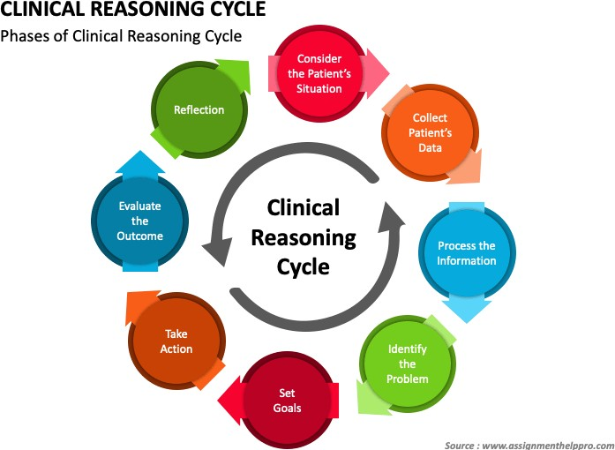
Clinical reasoning
Notes:
The clinical reasoning cycle is a tool that helps HP make decisions by considering many factors and stimulating critical thinking.
Look: Consider the current context and what is most important for the patient
Collect: Gather information
Process: Consider the information in the context of the patient's situation
Identify: Identify the problem or issue
Establish goals: Determine what is important in the short-term and potentially mid- to long-term
Take action: Decide on the best course of action
Evaluate outcomes: Consider what has changed after taking action
Reflect: Consider what has been learned from the process

Slide 22
Principle 2
Members behave ethically
  Members adhere to legal, regulatory and ethical requirements
  Members act with integrity, honesty , respect and openness
  Members fulfil their responsibilities within relevant professional and social contexts

Slide 23
Members behave ethically
Key points:
Adhere to legal, regulatory and ethical requirements
GDPR
Confidentiality
Justify and reflect on ethical decisions
Understand and manage personal beliefs and the beliefs of others
Highlight concerns
Be honest and truthful when advertising
Recognise the impact of life outside of work
Recognise and challenge health inequalities
Communicate in a professional manner
Disclose any financial benefit

Slide 24

Information governance and confidentiality
Information governance is regulated by the Caldicott guardians in trusts
It’s a legal framework that dictates how we handle and share personal
and identifiable information in the NHS
Includes :
  NHS act 2006
  Health and social care act 2012
  Data protection act
  Human rights act
This now also includes GDPR

Slide 25

GDPR
10 key requirements:
  Lawful , fair and transparent processing
  Limitation of purpose, data and storage
  Data subject rights :
    Right to be informed
    Right of access
    Right of rectification
    Right to erasure
    Right to restrict processing
    Right to data portability
    Right to object
    Rights related to automated decision making including profiling
  Consent
  Personal data breaches
  Privacy by design
  Data protection impact assessment
  Data transfers
  Data protection officer
  Awareness and. Training

Slide 26
Effective documentation: SOAP notes
Subjective | Consent How the patient is feeling that day Any medical updates Anything you discussed with the patient
Observations | Assessment of the patient A-E assessment Risk assessment
(Treatment) | Step by step detail of what you did with the patient
Analysis | Sum up of all the above Clinical reasoning and justification of rx choices Recommendations and future plans
Plan | What your goals are What you will do with the patient next session

Slide 27
Principle 3: CSP members deliver an effective service
Members put individuals at the centre of what they do
Members communicate effectively
Members work effectively with others

Slide 28
Members deliver an effective service
Key
Key points :
Understand
Understand an individual’s needs and tailor your service to them
Be
Be aware of vulnerabilities and act with compassion
Behave
Behave in a non-discriminatory manner respecting cultural differences ad beliefs
Communicate
Communicate effectively with others by adapting to specific needs
Engage
Engage with other members of the MDT and support their work within their scope of practice

Slide 29
Other members of the MDT
Some MDT members that you may come into contact with :
  Doctors
  Physician’s assistants
  Nurses
  Nursing associates and health care assistants
  Admin staff
  Other AHPs:
    Occupational therapists
    Speech and language therapists
    Dieticians
    Play and art therapists

Slide 30
Understanding the needs of your patient
Be aware of cultural beliefs and values that your patients may have
Understand disabilities and how we need to change our approach to accommodate this eg. Patients who are blind
Do they need translation?
Learning disability passports
ADAPTATION and Accommodation
Notes:
Learning disability passports: list of needs of the patient and how the health care service can help make you feel comfortable.

Slide 31
Principle 4 CSP members strive to achieve excellence
Members contribute to continuous improvement
Members demonstrate innovation and leadership
Members support others’ learning and development
Members contribute to the development of physiotherapy practice

Slide 32
Members strive to achieve excellence
Key points:
Maintain and promote high standards in physiotherapy
Engage in data collection
Engage in career long learning
Contribute to evidence base for physiotherapy
Share learning with others through reflection
Identify knowledge gaps and contribute to research
Be aware of learning needs with the changing scope of practice in
physiotherapy
Notes:
HCPC standards of proficiency can serve as a guide

Slide 33
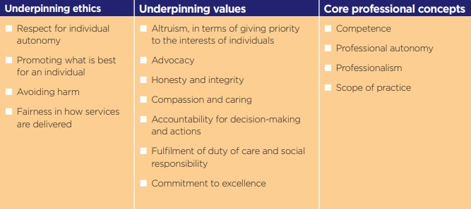
Underpinning ethics, values and concepts

Slide 34
Case Scenario 1
Sarah, a newly qualified physiotherapist, is treating a high-profile client with a knee injury. One day, while talking to her colleagues in the staff room, she shares details of the client’s treatment plan and progress. One of her colleagues reminds her that this might be a breach of patient confidentiality.

Slide 35
Case Scenario 2
Tom, a senior physiotherapist, is working with an elderly patient, Mr. Johnson, who has difficulty understanding the treatment being proposed due to hearing loss and mild cognitive impairment. Tom explains the procedure quickly and begins treatment without ensuring that Mr. Johnson fully understands or agrees to it.

Slide 36
Case Scenario 3
Emily, a physiotherapist, is treating a regular patient, Mark, who has been seeing her for six months for a chronic back condition. Mark has expressed his appreciation by giving her small gifts, and recently, he asked Emily to have dinner with him outside of work. Emily feels conflicted because she enjoys working with Mark but is unsure whether accepting the offer is appropriate.

Slide 37

Questions?

Slide 38
References
Hcpc-uk.org. (2011). Professionalism in healthcare professionals |. [online] Available at:
https://www.hcpc-uk.org/resources/reports/2011/professionalism-in-healthcare-professionals/.
CSP (2019). Code of Members’ Professional Values and Behaviour. [online] The Chartered Society of Physiotherapy. Available at: https://www.csp.org.uk/publications/code-members-professional- values-behaviour.
The Chartered Society of Physiotherapy. (n.d.). About the CSP. [online] Available at:
https://www.csp.org.uk/about-csp.
Information Commissioners Office (2019). The Principles. [online] Ico.org.uk. Available at: https://ico.org.uk/for-organisations/guide-to-data-protection/guide-to-the-general-data- protection-regulation-gdpr/principles/.
Public Health England (2021). Clinical governance. [online] GOV.UK. Available at: https://www.gov.uk/government/publications/newborn-hearing-screening-programme-nhsp- operational-guidance/4-clinical- governance#:~:text=Clinical%20governance%20is%20the%20system.

